Slide 1


Slide 2
What?
Covid 19 is also called coronavirus .
The first case was found in the year 2019 December in Wuhan , China
Today the disease has spread worldwide.

Slide 3
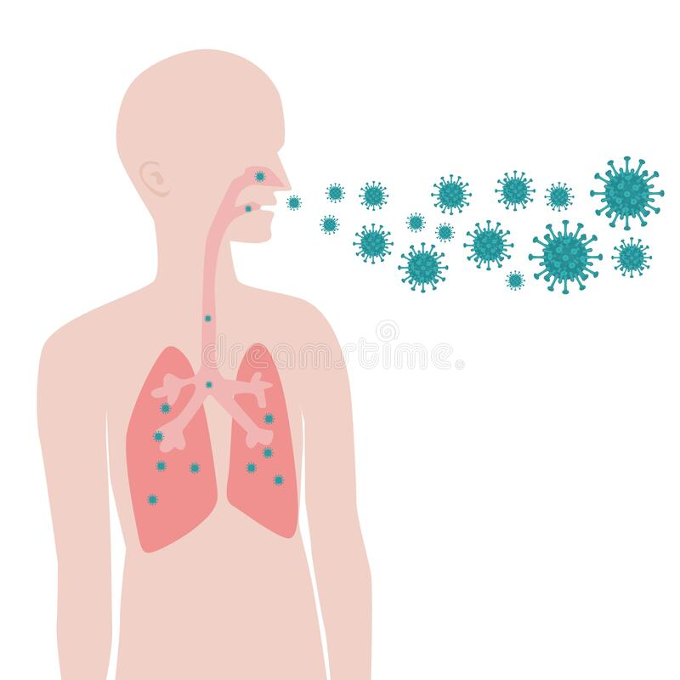
How?
The new coronavirus is a respiratory virus which spreads primarily through droplets generated when an infected person coughs or sneezes, or through droplets of saliva or discharge from the nose. To protect yourself, clean your hands frequently with an alcohol-based hand rub or wash them with soap and water.

Slide 4
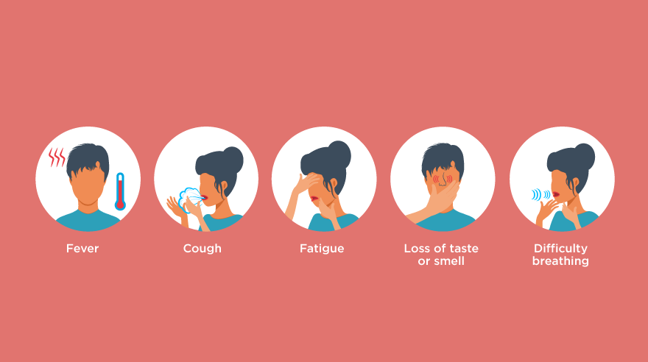
Symptoms

Slide 5
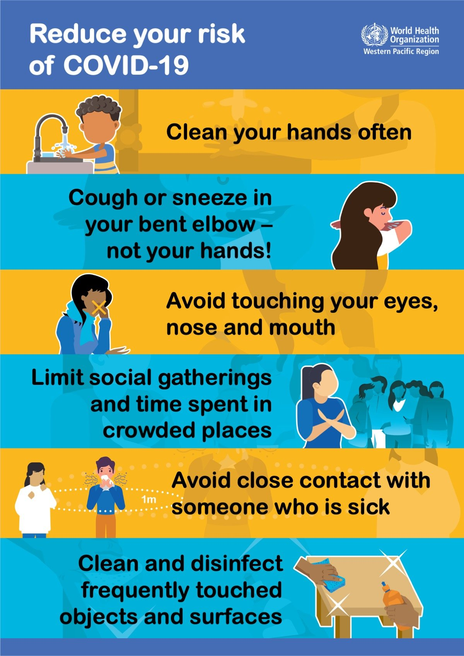

Slide 6


Slide 7


